Slide 1
Green ICT: Energy Harvesting Communications and Networking
Meng-Lin Ku
Department of Communication Engineering
National Central University
2018/04/17

Slide 2
Outline
Energy Harvesting in Wireless Communications
Ambient Energy Sources and Characteristics
Energy Scheduling
Energy Harvesting Models
Energy Harvesting Networking
Conclusions

Slide 3
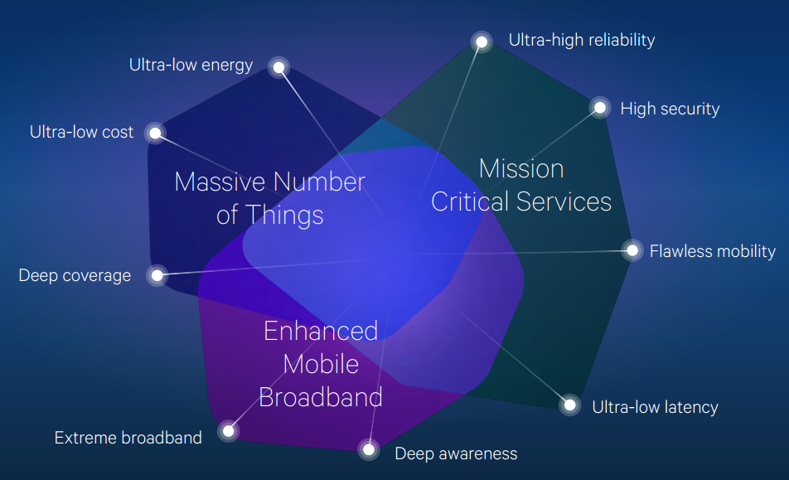
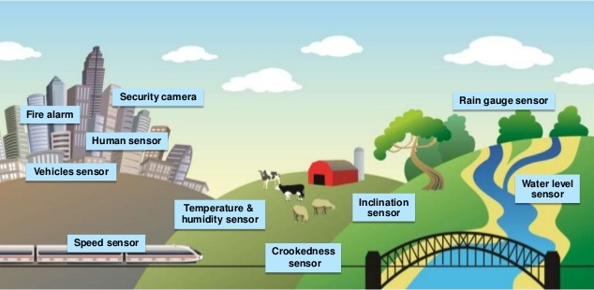
Green ICT and Life
[Source: SPANSION]
5G Vision

Slide 4
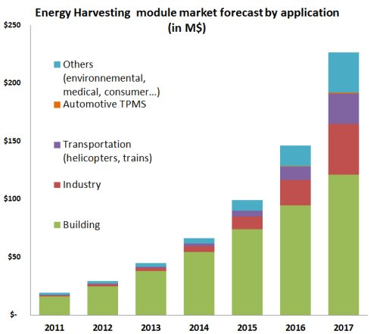
Energy Harvesting Market
[Source: Yole Développement Report]

Slide 5
Energy Harvesting in Wireless Communications
A new paradigm shift of power supply
less fossil fuels
more renewable energy
Advantages of ambient energy over grid or battery energy
self-sustainable capability
nearly permanent network lifetime
carbon footprint reduction
truly wireless nodes
easy and fast deployment
Emerging applications
remote environmental monitoring, consumer electronics, biomedical implants, etc.
Internet-of-Things (IoT)
green cellular infrastructures and systems

Slide 6
Green Power Sources
[Source: Nikola Tesla’s dream realized wireless power energy harvesting]

Slide 7
Ambient Energy Sources
Ambient energy sources in our daily life
physical effects or chemical effects
natural (solar/light, wind, liquid flow, etc.)
man-made (vibration, motion, electromagnetic wave, etc.)
intermittent, limited and random (time-varying) nature of renewable energy

Slide 8
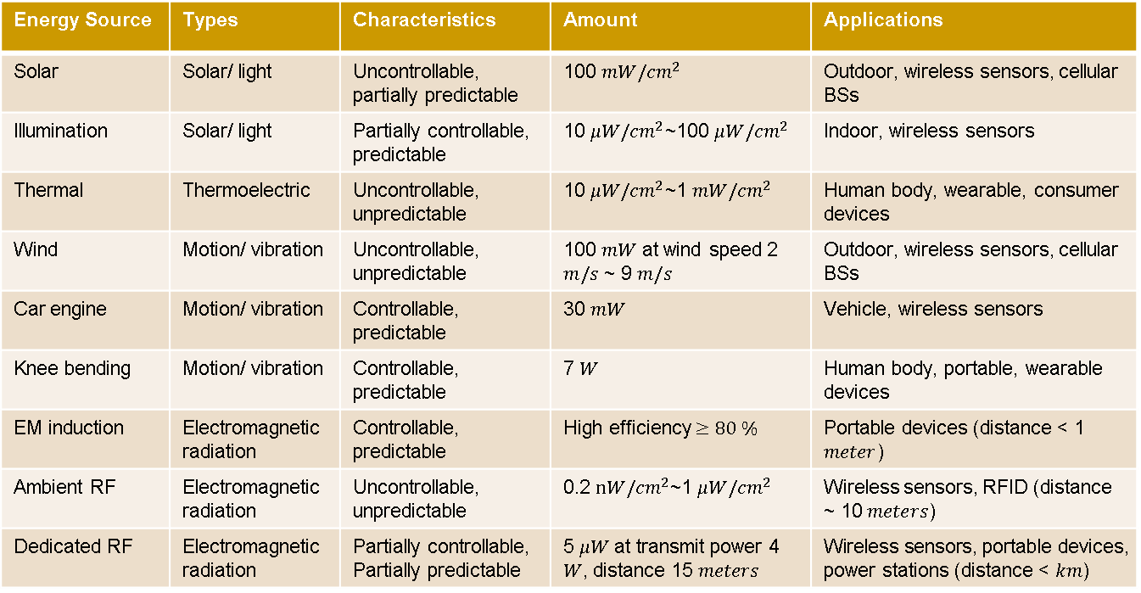
Characteristics of Ambient Energy Sources
Different characteristics of predictability, controllability and magnitude
Energy Source | Types | Characteristics | Amount | Applications
Solar | Solar/ light | Uncontrollable, partially predictable |  | Outdoor, wireless sensors, cellular BSs
Illumination | Solar/ light | Partially controllable, predictable |  | Indoor, wireless sensors
Thermal | Thermoelectric | Uncontrollable, unpredictable |  | Human body, wearable, consumer devices
Wind | Motion/ vibration | Uncontrollable, unpredictable |  | Outdoor, wireless sensors, cellular BSs
Car engine | Motion/ vibration | Controllable, predictable |  | Vehicle, wireless sensors
Knee bending | Motion/ vibration | Controllable, predictable |  | Human body, portable, wearable devices
EM induction | Electromagnetic radiation | Controllable, predictable
Ambient RF | Electromagnetic radiation | Uncontrollable, unpredictable
Dedicated RF | Electromagnetic radiation | Partially controllable, Partially predictable

Slide 9
Challenges in Energy Scheduling
Design challenges in energy scheduling
Energy neutrality:
the cumulative energy expenditure cannot surpass the cumulative energy harvested by that time.
Size of battery:
a battery or capacitor can be used as an energy buffer to smooth out the random effect of the scavenged energy.
Energy overflow problem:
the capacity of energy storage devices is limited.
Energy outage problem
the energy in the storage devices is exhausted.
Other practical considerations
efficiency in storing energy
energy leakage from storage devices
basic processing cost at communication nodes

Slide 10
Energy Scheduling Approaches
Three common protocols
harvest-use:
nodes are directly powered by energy harvesting devices without storage.
harvest-store-use:
energy can be used only after it is stored in the storage devices.
harvest-use-store:
energy temporarily stored in a super-capacitor is immediately used, and the remaining is stored.
Energy scheduling to harmonize energy consumption with battery recharge rates (CSI: channel state information; ESI: energy state information)
offline scheduling:
full (causal and non-causal) knowledge of CSI and ESI during the energy scheduling period is known to the transmitter side a priori.
online scheduling:
only causal knowledge of the CSI and ESI or some statistical knowledge of the channel and energy harvesting dynamic processes are required.

Slide 11
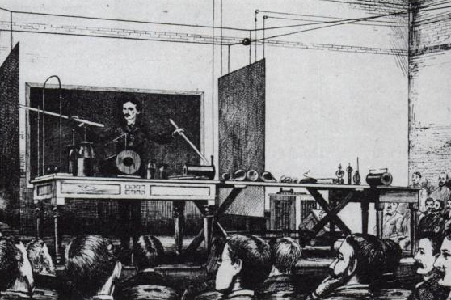
Nikola Tesla’s Dream
1882- Tesla Coil (high frequency, high voltage transformer)
188?- power transmission by radio waves (resonance to increase transmission of energy without wires)
1889- high-frequency transformer with coil diameter of 15 meters in Colorado Springs
1891- short-distance energy transmission for lighting lamps and driving receivers in NY
5G Vision
[Source: Wiki]
Visionary or charlatan ?
Notes:
在1882年他去了法國巴黎，在愛迪生公司做一名工程師，設計改進電器。同年特斯拉發明了感應馬達並開始開發各種用到旋轉磁場的設備（於1888年取得了專利）。
不久以後，特斯拉因得知母親病危而急匆匆地離開巴黎，剛到達不久後的幾個小時母親就死了，當時是1882年4月。她臨終前的最後一句話是：「你終於來了，尼古拉，我的驕傲。」當她死後，特斯拉就病了。他在母親的出生地查茨和戈斯皮奇休養了兩三個星期。
1884年，特斯拉第一次踏上美國國土，來到了紐約。除了前僱主查爾斯·巴奇勒所寫的推薦函外，他幾乎是一無所有。這封信是寫給托馬斯·愛迪生的，信中提到：「我知道有兩個偉大的人，你是其中之一，另一個就是這個年輕人了。」愛迪生雇用了特斯拉，安排他在愛迪生機械公司工作。特斯拉開始為愛迪生進行簡單的電器設計，他進步很快，不久以後就能解決公司一些非常難的問題。特斯拉完全負責了愛迪生公司直流電機的重新設計。
1919年，特斯拉寫道：「如果他完成馬達和發電機的改進工作，愛迪生將提供給他驚人的5萬美元（如計入通貨膨脹，相當於今天（2006年）的一百萬美元）」。特斯拉說他的工作持續了將近一年，幾乎將整個發電機重新設計了，使愛迪生公司從中獲得巨大的利潤和新的專利所有權。當特斯拉向愛迪生索取5萬美元時，愛迪生回答他：「特斯拉，你不懂我們美國人的幽默」，就此違背了自己的諾言^{[18][19]}。這筆獎金的金額相當於公司創始資本，而以特斯拉當時每周18美元的薪水，他需要工作53年才能賺到。當特斯拉要求加薪至每周25美元遭到拒絕後辭職。

Slide 12
Simultaneous Information and Power Transfer
By leveraging RF signals, information and power are simultaneously delivered by transmitters.
Due to circuit design constraint, it is impossible to realize simultaneous signal decoding and energy harvesting.
Two common protocols are considered:
time-switching
power-splitting
Tradeoff between the rates of energy transfer and information transmission

Slide 13
Energy Harvesting Models
Deterministic models
causal ESI
convex optimization
performance improvement with an
increased scheduling period
difficulty of prediction on ESI for a
large scheduling period
Stochastic models
Bernoulli, Poisson, two-state (on/off)
correlated process, generalized
Markov chains.
Markov decision process (MDP)
modeling mismatch problems
training of underlying model parameters

Slide 14
Energy Harvesting Models
Examples of stochastic solar energy harvesting model:
Examples of Markov decision process:
running a company
saving money or advertising

Slide 15
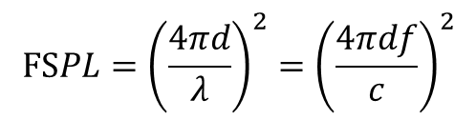
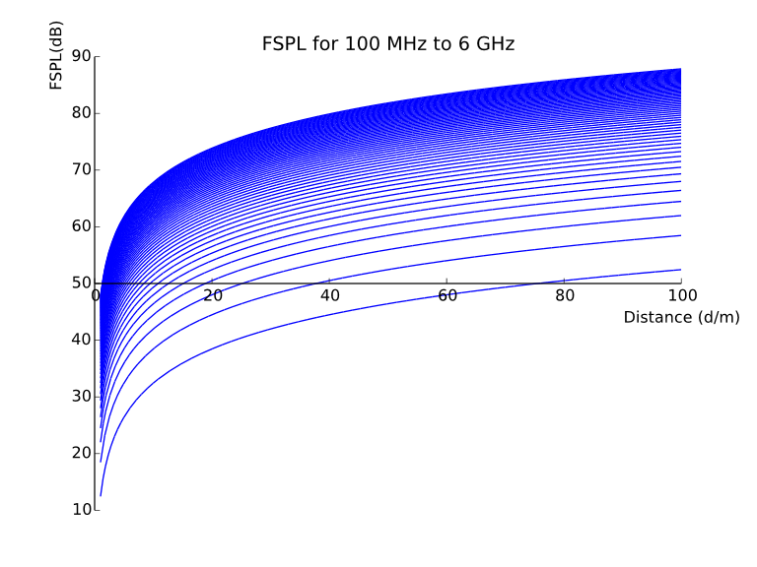
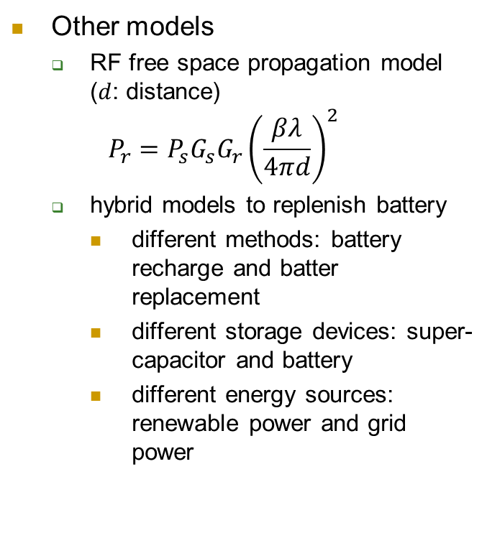
Energy Harvesting Models
Other models
RF free space propagation model ($d$: distance)
$$P_{r}=P_{s}G_{s}G_{r}{\left(\frac{βλ}{4πd}\right)}^{2}$$
hybrid models to replenish battery
different methods: battery recharge and batter replacement
different storage devices: super-capacitor and battery
different energy sources: renewable power and grid power
[Source: Wiki]

Slide 16
Related Design Issues
Design issues in energy harvesting communications:

Slide 17
Energy Harvesting Networking
The spirit of cooperation among nodes has fostered tremendous progress on the development of modern wireless communications.
Energy harvesting is being applied in different network topologies
cooperative networks
cognitive radio networks
multi-user interference networks
cellular networks

Slide 18
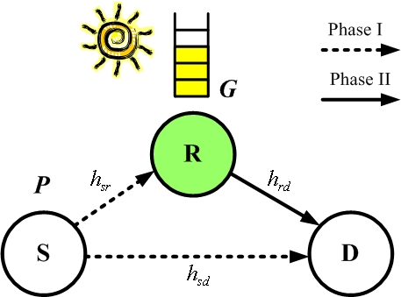
Cooperative Energy Harvesting Networks
Cooperative communications
information cooperation
virtual multi-input multi-output systems using relays
achieving spatial diversity
Energy harvesting in cooperative communications
self-sustainable cooperative relays for throughput and reliability improvement
tradeoff between link performance of each hop and battery recharge rate at each node
perpetual cooperative network lifetime
Recent research issues have been revisited
power allocation:
transmit power of source and relay nodes
scheduling:
direct transmission or relaying

Slide 19
Cooperative Energy Harvesting Networks
time switching/power splitting:
tradeoff between signal relaying and energy harvesting
antenna selection:
optimum antenna sets for signal relaying and energy harvesting
multiple sources and destinations:
game theory approaches, e.g., coalitional game, non-cooperative game
relay selection:
leveraging energy harvesting opportunity
multi-hop relay:
power allocation, routing and scheduling among multiple hops
Energy cooperation is another new dimension of cooperation
heterogeneity and variability of energy harvesting conditions among nodes
dedicated energy harvesting for sharing energy among nodes

Slide 20
Cooperative Energy Harvesting Networks
Applications in 5G: energy and information cooperation in cellular networks
[Source: Cost-Aware Green Cellular Networks with Energy and Communication
Cooperation]

Slide 21
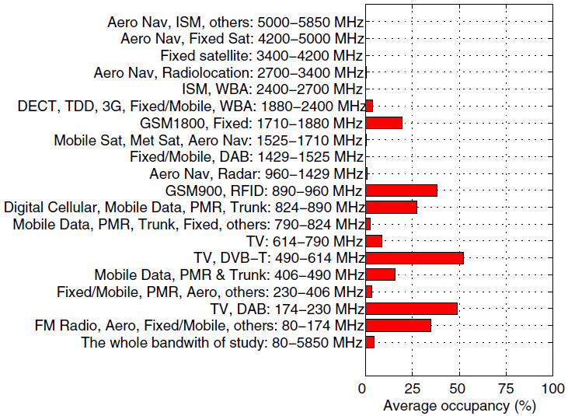
Cognitive Energy Harvesting Networks
Cognitive radio
key enabling technology to resolve the spectrum scarcity problem
secondary users sharing the spectrum owned by primary users with one-way or full cooperation
spectrum overlay and spectrum underlay
cognitive relaying (cooperative communication plus cognitive radio)
Power
Spectrum holes
Time or Space
Dynamic spectrum access
Frequency
Spectrum occupied by licensed users

Slide 22

Cognitive Energy Harvesting Networks
Energy harvesting in cognitive radio
green energy to support dynamic spectrum access
four conflicting objectives due to unstable energy sources and limited spectrum resource:
obtaining the knowledge of spectrum activity
protecting primary users from interference or collision
maximizing the transmission opportunity of secondary users
harvesting, spending or conserving energy
Primary user
Secondary user

Slide 23
Cognitive Energy Harvesting Networks
Applications in 5G: energy harvesting D2D communications
[Source: Energy Harvesting Aided Device-to-Device Communication Underlaying the
Cellular Downlink]

Slide 24
Cognitive Energy Harvesting Networks
Recent research issues have been revisited
spectrum sensing and access:
when to sense spectrum and when to access channel with harvested energy
spectrum occupancy:
partially observable MDP with incomplete spectrum occupancy
opportunistic harvesting and transmission:
secondary users using an idle channel to transmit data and a busy channel to recharge the battery
spectrum overlay and underlay:
mode selection of spectrum usage
robust design for multiple antennas:
channel uncertainty problem in sensing and harvesting
cognitive relay:
tradeoff between time duration of energy harvesting, data transmission and cooperative transmission
joint spectrum, information and energy cooperation

Slide 25
Multi-user Energy Harvesting Networks
Four types of multi-user scenarios
multiple access channels
broadcast channels
multicast channels
multi-user interference channels

Slide 26
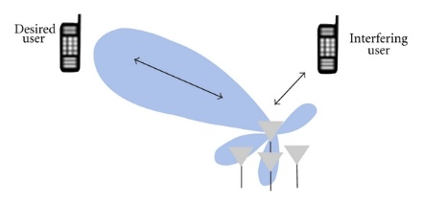
Multi-user Energy Harvesting Networks
Recent research issues have been revisited
multiple access channels
RF (radio beamforming) beamforming and time allocation
coexistence of battery and harvesting nodes
node selection and energy scheduling
broadcast channels
MIMO (multiple antennas) RF harvesting
rate allocation and precoder designs
power control and user fairness
multicast channels
MIMO, harvesting and decoding model switching
physical-layer security
multi-user interference channels
MIMO, power allocation and interference management
interference alignment and antenna selection
Beamforming
technology

Slide 27
Energy Harvesting Cellular Networks
Energy harvesting cellular networks
Simultaneous wireless information and power transfer (SWIT) in downlink
Wireless-powered cellular networks (WPCN) in uplink
Recent research issues have been revisited
hybrid energy:
resource allocation with a solar/wind energy harvester and a conventional power grid

Slide 28
Energy Harvesting Cellular Networks
broadband communications:
transmission and processing energy cost in energy harvesting multicarrier systems
grid power saving and base station turning-off:
grid power minimization with blocking probability constraints
energy transfer and sharing:
information transmission and energy transfer in TDD or FDD modes
cell deployment:
deployment of renewable harvesters for base stations
heterogeneous cellular networks:
base stations with different energy harvesting rates, energy storage capacity and deployment densities
power stations:
uplink cellular networks overlaid with randomly deployed power stations

Slide 29
On-going Development in Energy Harvesting
Fundamental limits of energy harvesting channel capacity
channel capacity with ESI side information
channel capacity with energy harvesting receivers
Energy harvesting at receiver side
energy consumption of signal reception and decoding at the receivers
balance between energy harvesting transmitters and receivers
Energy harvesting models and combination of heterogeneous energy sources
energy arrival characteristics for different energy sources
time-variant battery recharging rates
integration of multiple energy sources, e.g., solar and vibrational sources for wearable devices

Slide 30
On-going Development in Energy Harvesting
Robust designs with imperfect knowledge
time-variant ESI and CSI due to dynamic activities of energy sources or the mobility of nodes
tradeoff between CSI estimation and limited energy resources
other knowledge, e.g., primary user’s activity in cognitive radio, battery storage conditions among nodes
Multiple antenna techniques
beamforming, space-time coding, distributed antennas, and massive MIMO for energy-efficient transmissions
high-resolution beams for wireless RF energy harvesting
Security in RF energy harvesting
sensitivity of energy receivers larger than that of information receivers
physical-layer security due to near-far problems
energy receivers as eavesdroppers

Slide 31
On-going Development in Energy Harvesting
Energy harvesting networks with multiple nodes
routing, multi-hop relaying, relay selection
energy, spectrum, and information cooperation from game theory
distributed energy scheduling, device-to-device communications, machine-to-machine communications
cross-layer optimization
green small cells
Energy harvesting for activity recognition
energy harvesting computing
non-uniform property of energy harvesting power signals as the source for activity recognition
different activities (e.g., walking and running) generating kinetic power signals with different signatures (e.g., maximum values and autocorrelation values)

Slide 32
Conclusions
Energy harvesting techniques have been proposed as a revolutionary solution toward green, untethered and ubiquitous communications.
In this talk, we presented an overview of recent developments in energy harvesting communications and networks.
Several essential issues, including characteristics of different energy sources, fundamental concepts of energy scheduling approaches, research challenges and topics on energy harvesting, and directions for future research, were discussed.
Notes:
Wirelectriy: https://www.youtube.com/watch?v=MgBYQh4zC2Y
TI energy harvesting sensors: https://www.youtube.com/watch?v=nLR6k-Nk1o0

Slide 33
References
Meng-Lin Ku*, Yan Chen and K. J. Ray Liu, "Data-Driven Stochastic Models and Policies for Energy Harvesting Sensor Communications," IEEE Journal on Selected Areas in Communications: Wireless Communications Powered by Energy Harvesting and Wireless Energy Transfer, Vol. 33, No. 8, pp. 1505-1520, Aug. 2015.
Wei Li*, Meng-Lin Ku, Yan Chen and K. J. Ray Liu, "On Outage Probability for Stochastic Energy Harvesting Communications in Fading Channels," IEEE Signal Processing Letters, Vol. 22, No. 11, pp. 1893-1897, Nov. 2015.
Meng-Lin Ku*, Wei Li, Yan Chen and K. J. Ray Liu, "On Energy Harvesting Gain and Diversity Analysis in Cooperative Communications," IEEE Journal on Selected Areas in Communications: Green Communications and Networking, Vol. 33, No. 12, pp. 2641-2657, Dec. 2015.
Meng-Lin Ku*, Wei Li, Yan Chen and K. J. Ray Liu, "Advances in Energy Harvesting Communications: Past, Present, and Future Challenges," IEEE Communications Surveys and Tutorials, Vol. 18, No. 2, pp. 1384-1412, Second Quarter 2016.
Kun-Yueh Hsieh, Fan-Shuo Tseng* and Meng-Lin Ku, "A Spectrum and Energy Cooperation Strategy in Hierarchical Cognitive Radio Cellular Networks," IEEE Wireless Communications Letters, Vol. 5, No. 3, pp. 252-255, Jun. 2016.
Wei Li*, Meng-Lin Ku, Yan Chen and K. J. Ray Liu, "On Outage Probability for Two-Way Relay Networks with Stochastic Energy Harvesting," IEEE Trans. Communications, revised, Vol. 64, No. 5, pp. 1901-1915, May 2016.

Slide 34
Q&A
Thank you !

